Slide 1
Analyzing Denver Police Data for Pedestrian and Vehicle Stops

Slide 2
Introduction
Denver is is the capital and most populous city of the U.S. State of Colorado. It is located in the South Platte River Valley on the western edge of the High Plains just east of the Front Range of the Rocky Mountains. Denver is the 19th-most populous city in the United States, the fifth-most populous state capital, and the most populous city located in the Mountain states.
With a crime rate of 45 per one thousand residents, Denver has one of the highest crime rates in America compared to all communities of all sizes - from the smallest towns to the very largest cities.
So in this report we analyse person and vehicle stops by the Denver Police Department from the Computer Aided Dispatch system for the previous four calendar years and the current year to date.

Slide 3
Objectives
● Summarize the information in the table and create a report
● Create a CSV file with all the incidents in the most eventful neighborhood
● Top 10 incident neighborhoods by count
● Trend over time by number of incidents
● Derive additional insights

Slide 4
Data
The necessary data which we require to analyse the data is in the form of a .csv file which is of public use from the Denver government website.
This dataset includes person and vehicle stops by the Denver Police Department from the Computer Aided Dispatch system for the previous four calendar years and the current year to date. Data without a valid address is excluded from the dataset. This data is updated Monday through Friday.
There are thousands and thousands of data in the file, so it should be highly useful for the insights we need to generate.

Slide 5
Approach
Collect and download the open data from the website of Denver government
Import the data into our coding environment
Display the first few rows to ensure we have the data and it’s imported in a correct way
Using various visualization and functions, we generate and develop the required graphs.

Slide 6
Results

Slide 7
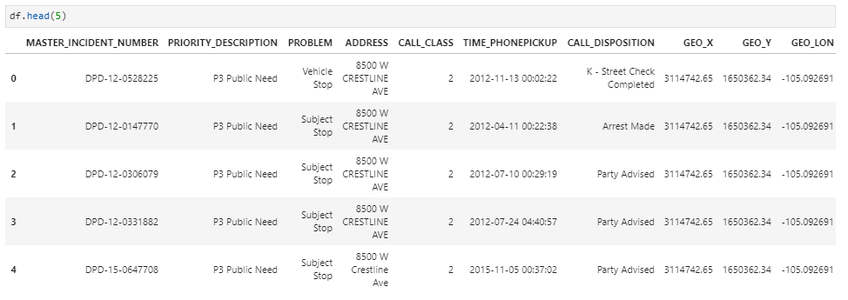
Displaying the first few rows of the data

Slide 8
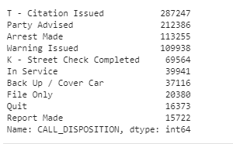
Top 10 pedestrians and vehicle stops made by Denver Police and their count

Slide 9
Visualization of Top 10 pedestrians and vehicle stops made by Denver Police and their count in a bar plot

Slide 10
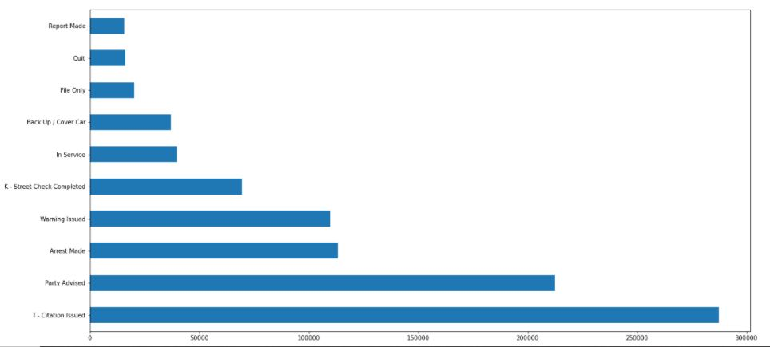

Slide 11
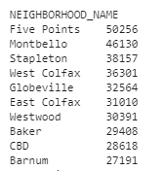
Top 10 incident neighborhoods with count

Slide 12
Visualization of top 10 incident neighborhoods

Slide 13
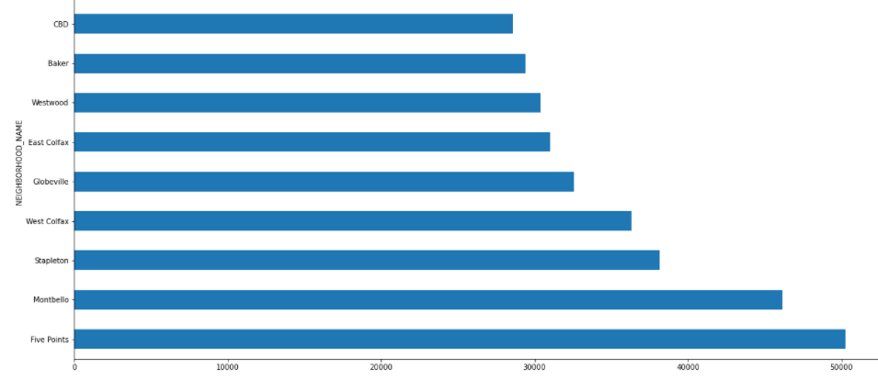

Slide 14


Creating a CSV file with all the incidents in the most eventful neighborhood and the query used
The created .csv file will be shared with the Jupyter notebook using GitHub link

Slide 15
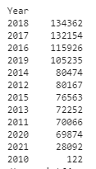
Visualizing incidents over time

Slide 16
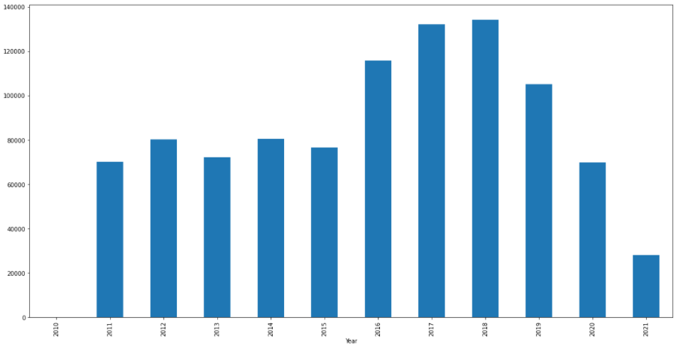

Slide 17
Conclusion
We have analysed and visualized the objectives for this report.
T - Citation issued and Party advised were the most occurred incident in Denver with a total count of 287247 and 212386 respectively.
We also found out that the neighborhood with the most incidents was Five Points with 50256. Montbello came out second with the second most incident hit neighborhood with a count of 46130
As part of the objectives, we created a separate csv file for Five Points neighborhood as it was highest in terms of incidents reported.
In order to visualize incident trends over time, we seperated year and month from the date column and visualized the year data separately.
With the visualized data considering the years, we found out that 2018 had the most number of incidents at 134362 with 2017 closely followed with reported incidents of 132154

